Slide 1
CSI 117 Introductory Object-Oriented Program Analysis & Design
Gaddis Chapter 4 – Part 1
Decision Structures and Boolean Logic

Slide 2
Objectives
Read flowcharts
Describe the Structure Theorem and the 3 basic control structures
Write pseudocode for 3 types of selection structures
Evaluate Boolean expressions to make comparisons
Use the relational operators
Use selections within ranges
Describe common errors using range checks

Slide 3
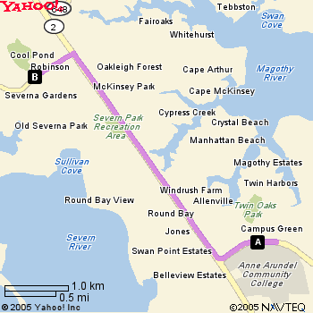
Graphical vs. Textual
While we are learning, we will see representation of program in 2 distinct ways
1. Start at 101 COLLEGE PKWY, ARNOLD - go 0.1 mi
2. Make a U-turn at ANNE ARUNDEL COMMUNITY COLLEGE RD, COLLEGE DR onto COLLEGE PKY - go 0.6 mi
3. Turn R on MD-2 NORTH - go 2.5 mi
4. Turn L on ROBINSON RD - go 0.4 mi5.Arrive at 50 ROBINSON RD, SEVERNA PARK, on the R

Slide 4
Drawing Flowcharts
Flowchart: a pictorial representation of the step-by-step solution to the problem
Program steps are in boxes, connected with flowlines (arrows) to show the order of processing
ANSI standard requires use of specific symbols

Slide 5
Drawing Flowcharts
Symbols on a flowchart:
Terminal symbol: beginning or end of a method
Annotation symbol: provides designer comments for a step
Process: an action taken
Input/output: denotes data coming in from or going out on a device

Slide 6
Drawing Flowcharts
Symbols on a flowchart:
Decision: condition or test
Predefined process: a call to another method
Flowlines: flow of control

Slide 7
Structure in Object-Oriented Methods
All methods/modules/functions in a program must be structured
Follows a specific set of rules for logical design
Have a single entry and exit point
Using structured programming techniques makes it possible for other people to understand and maintain program

Slide 8
Structure in Object-Oriented Methods
Spaghetti code: unstructured code that is confusing and complex due to poor structure
Flowchart of spaghetti code shows crossed flow paths with no clear path from beginning to end
Unstructured code is difficult to read, understand, and modify

Slide 9
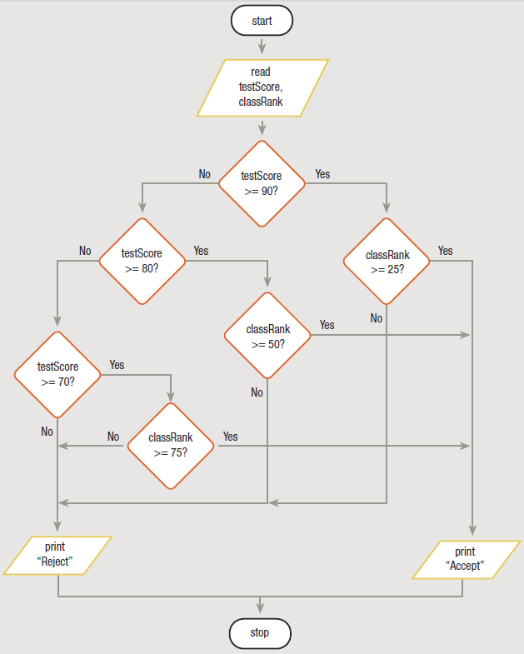
Structure in Object-Oriented Methods
Notice how the flowlines cross one another. This diagram is very difficult to interpret because the code is not structured and it is very difficult to determine how the program works.

Slide 10
Structure Theorem
Control structure – a basic unit of programming logic that controls flow of program statements
Structure Theorem states: It is possible to write any computer program by using only 3 basic control structures:
sequence,
selection, and
repetition

Slide 11
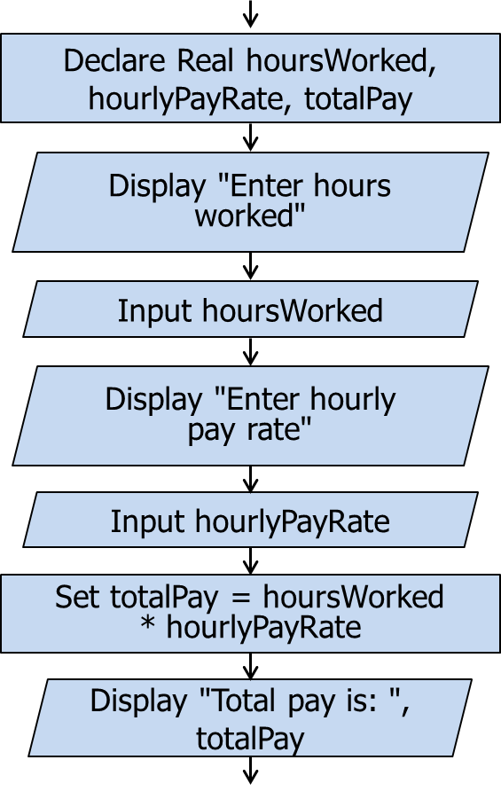
Three Control Structures
Flowchart
Sequence structure: one step followed by another, with no branching or looping
Pseudocode
Declare Real hoursWorked, hourlyPayRate, totalPay
Display "Enter hours worked"
Input hoursWorked Display "Enter hourly pay rate"
Input hourlyPayRate Set totalPay = hoursWorked * hourlyPayRate
Display "Total pay is: ", totalPay

Slide 12
Three Control Structures
Selection structure: choose an action from among alternatives based on a decision, condition, or test
Flowchart
hoursWorked <= MAX
False
True
Set totalPay = (MAX * hourlyPayRate) + ((hoursWorked – MAX) * hourlyPayRate * OVERTIME)
Set totalPay = hoursWorked * hourlyPayRate
Pseudocode
If hoursWorked <= MAX Then
Set totalPay = hoursWorked * hourlyPayRate
Else
Set totalPay = (MAX * hourlyPayRate) +
( (hoursWorked - MAX) *
hourlyPayRate * OVERTIME)
End If

Slide 13
Three Control Structures
Flowchart
Loop structure: repeat a set of steps while something is true
Set count = 0
count < MAX
True
Display "Hello"
False
Set count = count + 1
Pseudocode
Set count = 0
While count < MAX
Display "Hello
Set count = count + 1
End While

Slide 14
Selection Structure
Selection structure is one of the basic control structures used in structured programming
Ability to make a decision (selection) makes it possible for computer program to solve complicated problems
Selection cannot be used by itself to create a complete program; it must be combined with sequence and/or repetition

Slide 15
3 Types of Selection Structures
Single-alternative (If-Then)
A single block of statements to be executed or skipped
Dual-alternative (If-Then-Else)
Two blocks of statements, one of which is to be executed , while the other one is to be skipped
Multiple-alternative (Case)
More than two blocks of statements, only one of which is to be executed and the rest skipped

Slide 16
3 Types of Selection Structures
True
Single-alternative (If-Then)
A single block of statements to be executed or skipped
False
False
True
Dual-alternative (If-Then-Else)
Two blocks of statements, one of which is to be executed, while the other one is to be skipped

Slide 17
3 Types of Selection Structures
Multiple-alternative (Case)
More than two blocks of statements, only one of which is to be executed and the rest skipped

Slide 18
Single-Alternative (If-Then)
Flowchart
dentalPlanCode == 'Y'
False
True
Set grossPay = grossPay - 23.50
Pseudocode
If dentalPlanCode == 'Y' Then
Set grossPay = grossPay – 23.50
End If

Slide 19
Dual-Alternative (If-Then-Else)
Flowchart
hoursWorked > MAX
False
True
Set grossPay = MAX * rate + (hoursWorked – MAX) * OVERTIME * rate
Set grossPay = hoursWorked * rate
Pseudocode
If hoursWorked > MAX Then
Set grossPay = MAX * rate + (hoursWorked – MAX) * OVERTIME * rate
Else
Set grossPay = hoursWorked * rate
End If

Slide 20
Multiple-Alternative (Case)
Flowchart
Flowchart
modelNumber
Pseudocode
Select modelNumber
Case 100:
Set basePrice = 150000
Case 200:
Set basePrice = 170000
Case 300:
Set basePrice = 185000
Default:
Display "Invalid model"
Set basePrice = 0
End Select
100
200
300
default
Set basePrice = 150000
Set basePrice = 170000
Set basePrice = 185000
Display "Invalid model"
Set basePrice = 0

Slide 21
Boolean Expressions
Every decision made in computer program involves evaluating a boolean expression
Boolean expression evaluates to one of two states: true or false
dentalPlanCode == 'Y' and hoursWorked > 40 are boolean expressions
We must always compare values that are the same data type:
Compare a Real with another Real
Compare an Integer with another Integer
Compare a Character with another Character
Compare a String with another String

Slide 22
Relational Expressions
One type of boolean expression is a relational expression
Compares two values of the same type
Values compared can be variables or constants
Relational operators are: <, <=, >, >=, ==, !=
Binary operators, so there must be a value on both sides of the operator

Slide 23
Relational Expressions
Expression Result 3 > 6 false 6 > 3 true
6 < 3 false
6 >= 3 true
3 >= 6 false
3 == 6 false
6 != 3 true

Slide 24
Character and String Data Types
To compare character and string data, we use a collating sequence
A table that assigns a unique numerical value to each character.
To compare two characters, the processor uses their numerical values
A common collating sequence used to compare character and string data is the ASCII (pronounced ask-ee) collating sequence (American Standard Code for Information Interchange)

Slide 25
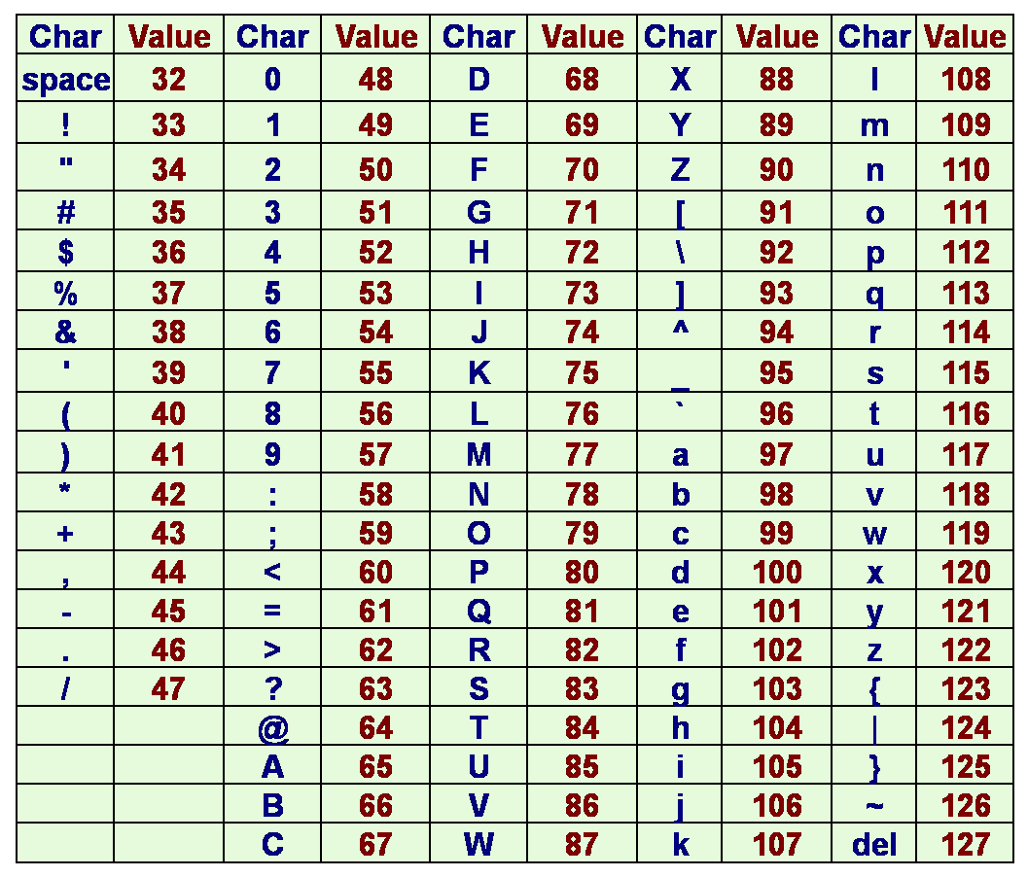
Character and String Data Types - ASCII Values
'A' < 'a' because 65 < 97
'B' > '4' because 66 > 52
'h' > '$' because 104 > 36

Slide 26
Character and String Data Types - ASCII Values
When comparing two strings, the comparison takes place one character at a time until:
a difference is found or
the end of one or both strings is encountered
Example compare "cat" and "coffee"
Step1: compare the first character of each–they are the same; the comparison continues
Step2: compare the second character of each—a difference is found 'a' < 'o'; the comparison ends

Slide 27
Using Relational Operators
Examples – the following are equivalent:
If customerAge >= 65 Then
Set discount = 0.10
Else
Set discount = 0
End If
If customerAge < 65 Then
Set discount = 0
Else
Set discount = 0.10
End If

Slide 28
Using Relational Operators
Negative comparisons can lead to double negatives – use caution!
customerCode != 1
If customerCode != 1 Then
Set discount = 0.25
Else
Set discount = 0.50
End If
False
True
Set discount = 0.50
Set discount = 0.25

Slide 29
Using Relational Operators
Rephrase question to eliminate double negative
customerCode == 1
If customerCode == 1 Then
Set discount = 0.50
Else
Set discount = 0.25
End If
False
True
Set discount = 0.25
Set discount = 0.50

Slide 30
Nested If Statements
Often more than one condition that must be considered to determine when an action should take place
Need more than one If statement
Can put one If statement within another one
Called a nested If

Slide 31
Nested If Statements
Can only reach this If statement when itemsSold > 3
This If statement is nested
If itemsSold > 3 Then
If valueSold >= 1000 Then
Set bonus = 50
Else
Set bonus = 25
End If
Else
Set bonus = 10
End If
False
itemsSold > 3
True
valueSold >= 1000
Set bonus = 10
False
True
Set bonus = 25
Set bonus = 50

Slide 32
Selection Within Ranges
A range check compares a variable to a series of values between limits
Make comparisons using either the lowest or highest value in each range of values
Low value of each range
Meeting Day and Time | Departments
Monday at 9 a.m. | 1 through 4
Monday at 1 p.m. | 5 through 9
Tuesday at 1 p.m. | 10 through 17
Wednesday at 9 a.m. | 18 through 20
High value of each range

Slide 33
Suppose we have the Employee class
Class Employee
Private String name
Private Integer dept
Public Module Employee ()
Set name = " "
Set dept = 0
End Module
Public Module Employee
(String newName
Integer newDept)
Set name = newName
Set dept = newDept
End Module
Public Module setName (String newName)
Set name = newName
End Module
Public Function String getName ()
Return name End Function
Public Module setDept (Integer newDept)
Set dept = newDept
End Module
Public Function Integer getDept ()
Return dept
End Function
End Class
+Employee -name: String -dept: Integer +Employee() +Employee(newName: String, newDept: Integer) +setName(newName: String) +getName(): String +setDept(newDept: Integer) +getDept(): Integer
cont’d.

Slide 34
Passing an object Consider the following application
Module main()
Declare Employee john
Declare Employee sue
Set john = New Employee("John Smith", 8)
Call printEmpInfo (john)
Set sue = New Employee("Sue Longo", 10)
Call printEmpInfo (sue)
End Module
Module printEmpInfo (Employee emp)
Display "Employee name: ", emp.getName ()
Display "Employee dept.: ", emp.getDept ()
End Module
+main() +printEmpInfo(emp: Employee)
Calling a method in the application and passing an object as an argument.
Notice format:
methodName (objectName)
The parameter is an Employee object.

Slide 35
Passing an object Let’s add another method that receives an object parameter to the application
Module main()
Declare Employee john
Declare Employee sue
Set john = New Employee("John Smith", 8)
Call printEmpInfo (john)
Set sue = New Employee("Sue Longo", 10)
Call printEmpInfo (sue)
End Module
Module printEmpInfo (Employee emp)
Display "Employee name: ", emp.getName ()
Display "Employee dept.: ", emp.getDept ()
End Module
Module printMemo (Employee emp)
Declare String meetingTime
Declare Integer department
Set department = emp.getDept ()
If department <= 4 Then
Set meetingTime = "Monday at 9 a.m. "
Else If department <= 9 Then
Set meetingTime = "Monday at 1 p.m. "
Else If department <= 17 Then
Set meetingTime = "Tuesday at 1 p.m. "
Else
Set meetingTime ="Wednesday at 9 a.m. "
End If
Display "To: " , emp.getName()
Display "From: Walter Braxton"
Display "Please meet with me on ", meetingTime, " in CALT220"
End Module
cont’d.
+main() +printEmpInfo(emp: Employee) +printMemo(emp: Employee)

Slide 36
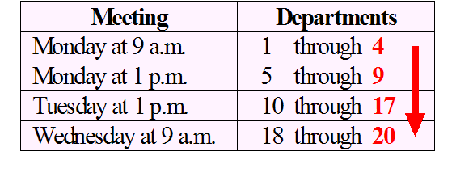
A closer look at the printMemo () method--Selection Within Ranges Using Highest Value of Each Range
Module printMemo (Employee emp)
Declare String meetingTime
Declare Integer department
Set department = emp.getDept ()
If department <= 4 Then
Set meetingTime = "Monday at 9 a.m. "
Else If department <= 9 Then
Set meetingTime = "Monday at 1 p.m. "
Else If department <= 17 Then
Set meetingTime = "Tuesday at 1 p.m. "
Else
Set meetingTime ="Wednesday at 9 a.m. "
End If
Display "To: " , emp.getName()
Display "From: Walter Braxton"
Display "Please meet with me on ", meetingTime, " in CALT220"
End Module
When using the highest value in each range to do range checking, always start with the lowest value.

Slide 37
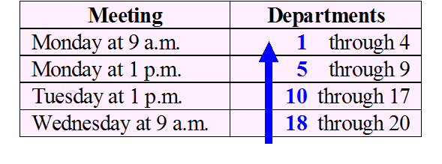
Another option for the printMemo () method-- Selection Within Ranges Using Lowest Value of Each Range
Module printMemo (Employee emp)
Declare String meetingTime
Declare Integer department
Set department = emp.getDept ()
If department >= 18 Then
Set meetingTime ="Wednesday at 9 a.m. "
Else If department >= 10 Then
Set meetingTime = "Tuesday at 1 p.m. "
Else If department >= 5 Then
Set meetingTime = "Monday at 1 p.m. "
Else
Set meetingTime = "Monday at 9 a.m. "
End If
Display "To: " , emp.getName()
Display "From: Walter Braxton"
Display "Please meet with me on ", meetingTime, " in CALT220"
End Module
When using the lowest value in each range to do range checking, always start with the highest value.

Slide 38
Common Errors Using Range Checks
Avoid logical paths that are unreachable
Avoid asking unnecessary questions that have just one possible answer or outcome

Slide 39
Common Error – Incorrect; Unreachable paths
If department >= 1 Then
Set meetingTime =" Monday at 9 a.m."
Else If department >= 5 Then
meetingTime = " Monday at 1 p.m."
Else If department >= 10 Then
meetingTime = " Tuesday at 1 p.m."
Else If department >= 18 Then
meetingTime = " Wednesday at 9 a.m."
End If

